Slide 1

2:18-29

Slide 2
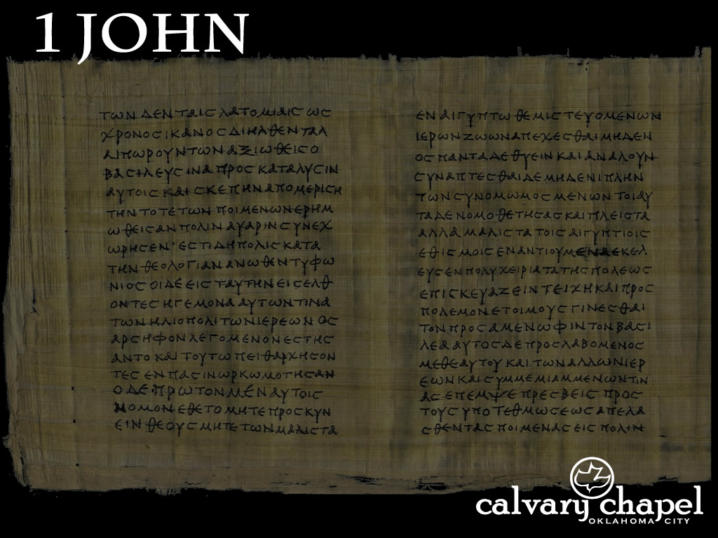
2:18-29
World ~ kosmos – The system that sets itself up as independent from God

Slide 3
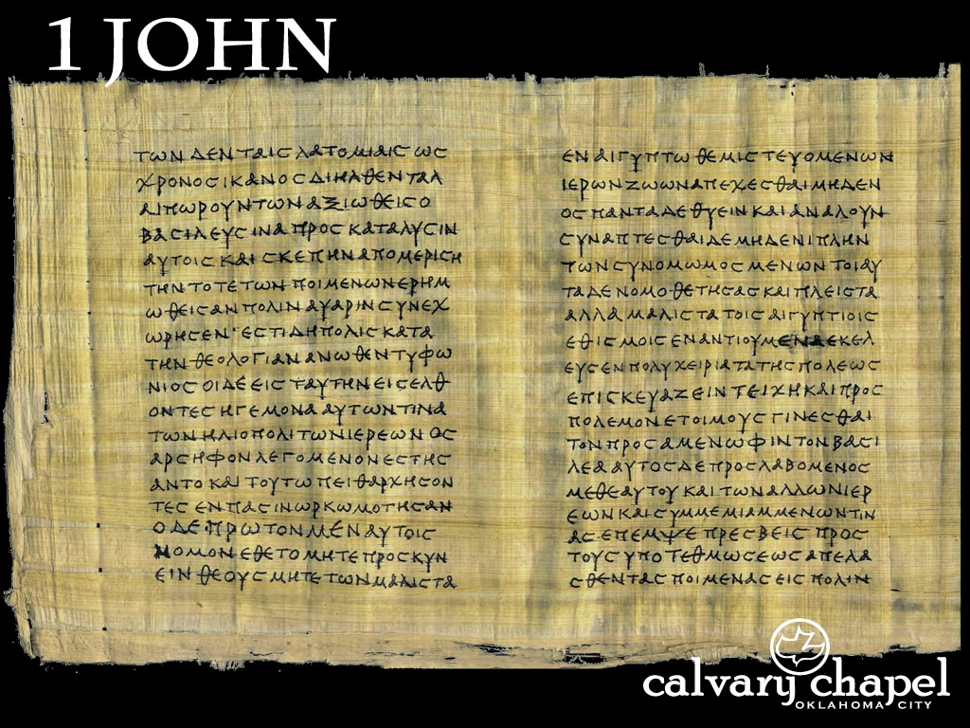
2:18-29

Slide 4


2:18-29
You need to get back to work now; you have a
has been to support
You need to get back to work now; you have a husband to support
Delivered

Slide 5
2:18-29

Slide 6

2:18-29
Zero hour

Slide 7
2:18-29

Slide 8
2:18-29
John 1:18 ~ No one has seen God at any time. The only begotten Son, who is in the bosom of the Father, He has declared Him.
Declared ~ exegeomai – to lead out or to go before
Matthew Henry ~ “The God who took a motherless woman out of the side of a man took a fatherless man out of the body of a woman.”

Slide 9
2:18-29
C. S. Lewis (Mere Christianity) ~ “Among the Jews there suddenly turns up a man who goes about talking as if He as God … Now let us get this clear … among pantheists … anyone might say that he was part of God, or one with God: There would be nothing very odd about it. But this man, since He was a Jew, could not mean that kind of God. God, in their language, meant the Being outside the world who made it and was infinitely different from anything else.

Slide 10
2:18-29
C. S. Lewis (Mere Christianity) ~ And when you have grasped that, you will see that what this man said was, quite simply, the most shocking thing that has ever been uttered by human lips.”

Slide 11
2:18-29
1 Cor. 15:13-14 ~ ¹³ But if there is no resurrection of the dead, then Christ is not risen. ¹⁴ And if Christ is not risen, then our preaching is empty and your faith is also empty.
Doctrine of the Resurrection
Gal. 1:8 ~ But even if we, or an angel from heaven, preach any other gospel to you than what we have preached to you, let him be accursed.
Doctrine of Salvation by Grace
1 John 4:3 ~ … and every spirit that does not confess that Jesus Christ has come in the flesh is not of God. And this is the spirit of the Antichrist, which you have heard was coming, and is now already in the world.
Doctrine of the Incarnation

Slide 12
2:18-29
Where is He?
A glorified Man in heaven
What did He do?
Salvation by grace through faith
Who is He?
God who became a Man

Slide 13
2:18-29

Slide 14
2:18-29
Joni Eareckson Tada ~ “When I look at Jesus’ warm and intimate friendships, my heart fills with praise that Jesus was…a man. A man of flesh-and-blood reality. His heart felt the sting of sympathy. His eyes glowed with tenderness. His arms embraced. His lips smiled. His hands touched. Jesus was male! Jesus invites us to relate to him as the Son of Man. And because he is fully man, we can relate to Jesus with affection and love.”

Slide 15
2:18-29

Slide 16

2:18-29
Rom. 12:4-7;
1 Cor. 12:4-31;
Eph. 4:7-16;
Heb. 10:19-25, etc.
Jesus
Bill
Sue
Em
Ken
Franz
Mary
Jorge
Ivan
Li
Al
Betty
Joe
James
Maria
Jack
Ann
Fiona
Tran
Heathcliff

Slide 17
2:18-29

Slide 18
2:18-29
1 Cor. 2:12-14 ~ ¹² Now we have received, not the spirit of the world, but the Spirit who is from God, that we might know the things that have been freely given to us by God. ¹³ These things we also speak, not in words which man’s wisdom teaches but which the Holy Spirit teaches, comparing spiritual things with spiritual. ¹⁴ But the natural man does not receive the things of the Spirit of God, for they are foolishness to him; nor can he know them, because they are spiritually discerned.

Slide 19
2:18-29

Slide 20
2:18-29
Rev. 2:6 ~ But this you have, that you hate the deeds of the Nicolaitans, which I also hate.
Nikē ~ to conquer ; laos ~ people
Hence, conquered people

Slide 21
2:18-29
Acts 17:11 ~ These were more fair-minded than those in Thessalonica, in that they received the word with all readiness, and searched the Scriptures daily to find out whether these things were so.

Slide 22
2:18-29

Slide 23
2:18-29
Vance Havner ~ “If the creation story, the virgin birth, the resurrection are only myths, then I'm myth‐taken and myth‐ified, and myth‐erable!”

Slide 24
2:18-29

